Slide 1
Maze
CSCI 352 project

Slide 2
Our Goal:
Entertainment for the people who are bored in during this Stay at Home period.
A Maze is auto-generated every time

Slide 3
Background
Perfect Maze
Orthogonal Maze
Binary Tree Algorithm
Notes:
PerfectMaze
'perfect' maze has every path connected to every other path, so there are no unreachable areas. Also, there are no path loops or isolated walls. There is always one unique path between any two points in the maze.
Orthogonal maze = rectangle maze
A binary tree maze is a standard orthogonal maze where each cell always has a passage leading up or leading left, but never both.

Slide 4
Requirements
User needs to be able to interact with the maze program
Maze needs to automatically created
Settings has custom options
Application makes mazes quickly
Scalability of the maze.

Slide 5
Approach
How we did it?
Shorten Version: Googled a lot
Longer Version:
Grace designed:
GUI Interface
Settings Backend
Maze Backend
Matthew designed:
High Scores Backend

Slide 6
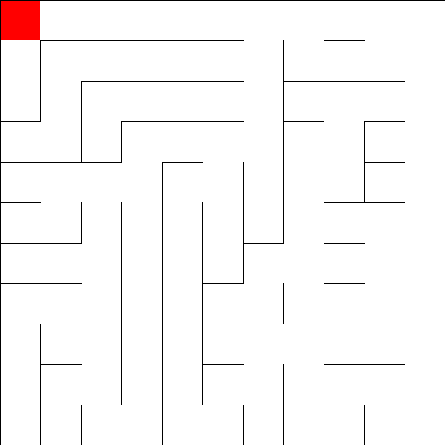
Project Structure

Slide 7
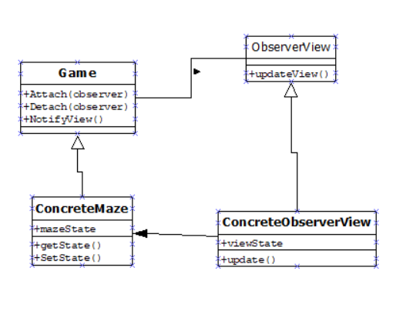
using the Observer Pattern to customize

Slide 8
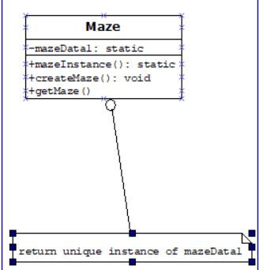
using the Singleton Pattern to initialize

Slide 9
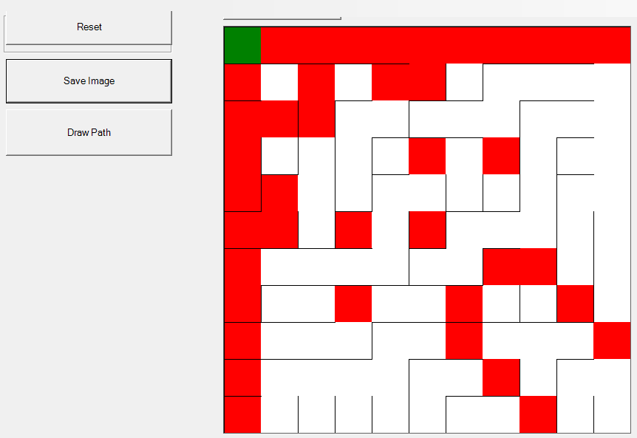
Notes:
Needs to show what the middle of the maze will look like

Slide 10


Customize Maze
Themes:
Brick
Stone Hedge
Bush
Creepy Dungeon
CUSTOMIZE
WALLS
FLOOR
Buttons
Music:
Creepy Music
Happy Music
No Music
HOME
Notes:
Character Ghosts?

Slide 11
High Scores
Name
OctoCat
mdp2222
MystiqueMae
Nathan4numbers
NOsleepSnorlax
unicorngll
Xxcrazy420xx
Xodystopian
1depression
Horselover1234
3xtr4bl1nd
Pantlessmaniac
Corgibuttox
Didneyworl
Epsteindidnotkms
High score
54654654
6555555
6546543
5543615
5326456
4546654
654465
554153
132552
78468
54646
46515
6463
5445
4586
Time
00:01:45
00:02:50
00:01:00
00:00:55
00:02:00
00:01:00
00:02:00
00:03:45
00:04:50
00:01:12
00:02:13
00:00:59
00:00:10
00:00:25
00:00:35
HOME

Slide 12
Developers
Matthew Pugh
Grace Looney
HOME

Slide 13
Future Goals
Allow for user interaction
Allow for score interaction

Slide 14
Contact:
Grace Looney:
gralloon@ut.utm.edu
Github: looneygrace1
Matthew Pugh:
Github Repo: https://github.com/looneygrace/Maze

